Slide 1
Drug Testing Update, Medical Marijuana and The Opiate Epidemic
Jeffrey Altholz MD
Clarity Testing Services

Slide 2
Jeffrey Altholz MD C-MRO
Certified Medical Review Officer and DOT Medical Examiner
Founder and Chief Medical Officer of Clarity Testing Services (1995), the premier provider of onsite drug testing and OSHA medical surveillance services in the Tristate area

Slide 3
Objectives
1. Update on the legalization of medical and recreational marijuana and implications in/for the workplace
2. Understand the challenges and current state of the art of drug and alcohol testing techniques and technologies
3. Appreciate the current trends in the local, regional and national epidemic of opiate abuse and associated morbidity and mortality and workplace ramifications

Slide 4
Marijuana
1. Designated a Schedule 1 substance by DEA (Federal)
2. “Highest abuse potential”
3. “No medical benefit”
3. Had been illegal in all US states for almost 100 years
(possession, use, transfer, cultivation, etc)
4. Long excretion half life, fat soluble THC metabolite

Slide 5
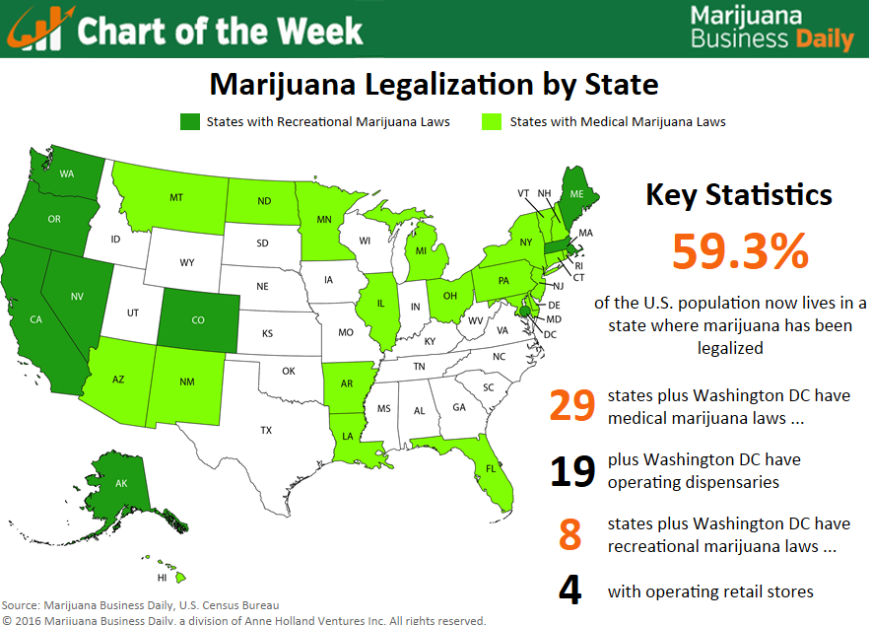

Slide 6
Current Status
1. Eight (8) states and Washington DC have legalized recreational marijuana
2. Nineteen (19) states have plus Washington DC have operating dispensaries
3. Twenty two (22) states have decriminalized small amounts of marijuana
4. Twenty nine (29)states have legalized medical marijuana
5. New Jersey began the process of debating legalization in June

Slide 7
Workplace Concerns
1. Significant impairment for 6-8 hours after use
2. Measurable effects 24-36 hours later
3. Safety sensitive concerns
4. Difficulty discriminating recent use from remote use by testing (more on this later)
5. Most MRO’s treat this similarly to prescription painkillers
6. Marijuana is still illegal on a Federal basis so mandatory regulated testing (Federal DOT, etc) cannot accept state marijuana cards

Slide 8
Drug Testing Update 2017
1. Testing Modality Comparison
(Hair, Urine, Saliva)
2. DOT Testing Panel Expansion
3. Marijuana

Slide 9
Hair, Urine, Saliva
1. Saliva/Oral Fluid-Most immediate and shortest duration (hours to 1-2 days), most closely linked to recent use and possible impairment
2. Urine-Most data and history, variable detection times, long recovery time for marijuana
3. Hair—Longest recovery time, no clear relationship to when a drug was used or possible impairment.

Slide 10
Sample Detection Times
Urine Saliva Hair
Amphetamine 3 days 3 days 90 days
Methamphetamine 3 days 3 days 90 days
Heroin 20 hours 2 days 90 days
Oxycodone 3 days 2 days 90 days
Marijuana 3-30 days 2-4 days 90 days
Xanax 5 days 3 days 90 days
Valium 10 days 3 days 90 days

Slide 11
DOT Testing Panel Expansion
1. Implemented January 1, 2018
2. Addition of oxycodone and hydrocodone and metabolites
3. IT’S ABOUT TIME!!!!!!

Slide 12
Marijuana Testing
1. Separating recent use from remote use
2. Link to impairment
3. Breath technology
4. Oral fluid testing

Slide 13
The Opiate Epidemic
1. Why Opiates?
2. Historical Overview
3. Oxycodone/Hydrocodone
4. Oxycontin
5. Heroin
6. Fentanyl
7. Trends

Slide 14
Why Opiates?
1. “I just found love and peace”
2. “Like being cradled to sleep by God”
3. “Multiply the best orgasm you’ve ever had by 1000”
4. “Like being hugged from the inside”
5. Strong physical addiction with extreme withdrawal
6. Cheap and plentiful supply of heroin when prescription drug supply tightened

Slide 15
Historical Overview
1. Opium poppies effects known during the times of the Greeks
2. Morphine purified and standardized 1830’s
3. Civil war created many morphine addicts
4. 1910 Heroin invented
5. 1970’s heroin crisis
6. Current opiate epidemic is the worst in history

Slide 16
Synthetic Opiates
1. Natural opiates codeine and morphine
2. Hydrocodone and oxycodone
3. Time released formulations

Slide 17
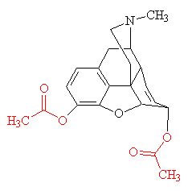
Heroin and Morphine
Morphine
Heroin

Slide 18
Fentanyl and Analogues
1. Fentanyl is 50-100 times more powerful than morphine
2. Carfentanil 10,000 times more powerful than morphine
3. Odorless, no taste, invisible liquid

Slide 19
Heroin and Fentanyl

Slide 20
Trends

Slide 21
Trends

Slide 22
Takeaways
1. The epidemic rages on and is widening
2. Drug treatment access is insufficient
3. Many of these substance abusers are employed full time
4. Drug testing can help facilitate treatment and recovery
5. This epidemic has hit every segment of society

Slide 23
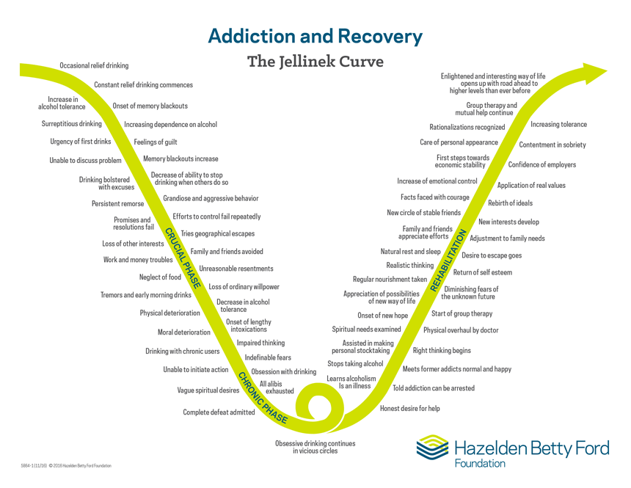

Slide 24
Medication Assisted Treatment (MAT)
1. Buprenorphine (Suboxone)
2. Vivitrol* (Naltrexone Extended Release)
3. Methadone

Slide 25
Recovery Prognosis
1. Family support
2. Job jeopardy
3. Union support
4. Good substance abuse treatment benefits
5. EAP access

Slide 26
Jeffrey Altholz MD
Clarity Testing Services
Phone: 914 593 0300
Email: DrJ@claritytesting.com
www.claritytesting.com

